Slide 1

vignan university

Slide 2
System Bus
The CPU sends various data values, instructions and information to all the devices and components inside the computer.
If you look at the bottom of a motherboard you'll see a whole network of lines or electronic pathways that join the different components together.
This network of wires or electronic pathways is called the 'Bus'.
vignan university

Slide 3
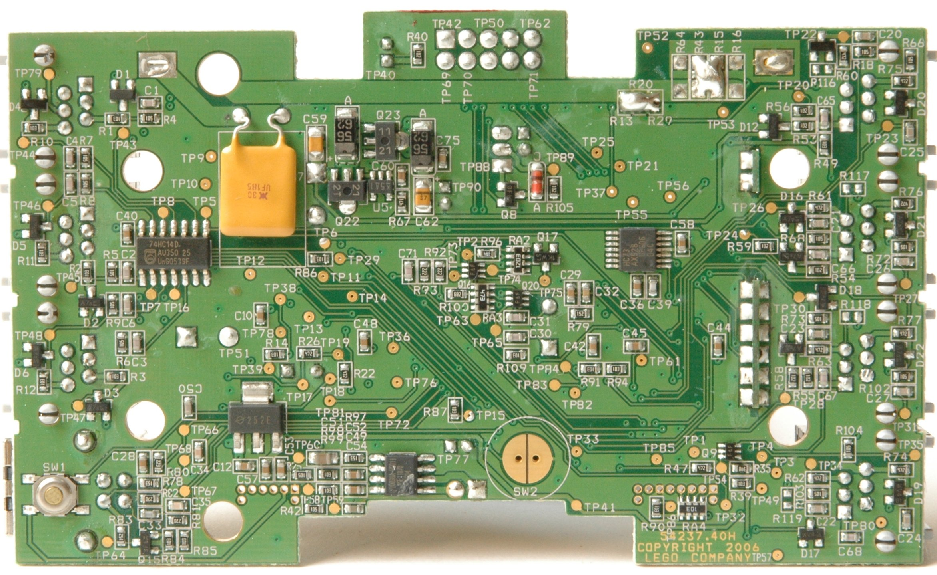
Bottom of Motherboard
System Bus
vignan university

Slide 4
Types of System Buses
Data Bus
Address Bus
Control Bus
vignan university

Slide 5
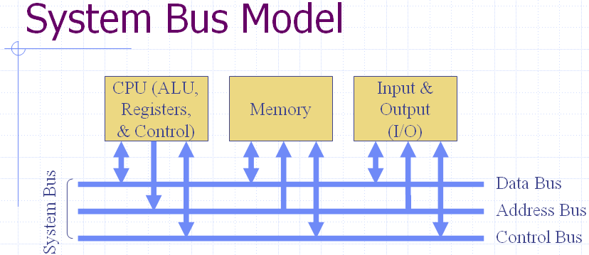
vignan university

Slide 6
Data Bus
A collection of wires through which data is transmitted from one part of a computer to another is called Data Bus.
Data Bus can be thought of as a highway on which data travels within a computer.
This bus connects all the computer components to the CPU and main memory.
vignan university

Slide 7
Data Bus
The size (width) of bus determines how much data can be transmitted at one time.
E.g.:
  A 16-bit bus can transmit 16 bits of data at a time.
  32-bit bus can transmit 32 bits at a time.
vignan university

Slide 8
Address Bus
A collection of wires used to identify particular location in main memory is called Address Bus.
Or in other words, the information used to describe the memory locations travels along the address bus.
vignan university

Slide 9
Address Bus
The size of address bus determines how many unique memory locations can be addressed.
E.g.:
  A system with 4-bit address bus can address 2⁴ = 16 Bytes of memory.
  A system with 16-bit address bus can address 2¹⁶ = 64 KB of memory.
  A system with 20-bit address bus can address 2²⁰ = 1 MB of memory.
vignan university

Slide 10
Control Bus
The connections that carry control information between the CPU and other devices within the computer is called Control Bus.
The control bus carries signals that report the status of various devices.
E.g.:
  This bus is used to indicate whether the CPU is reading from memory or writing to memory.
vignan university

Slide 11



vignan university

